Slide 1
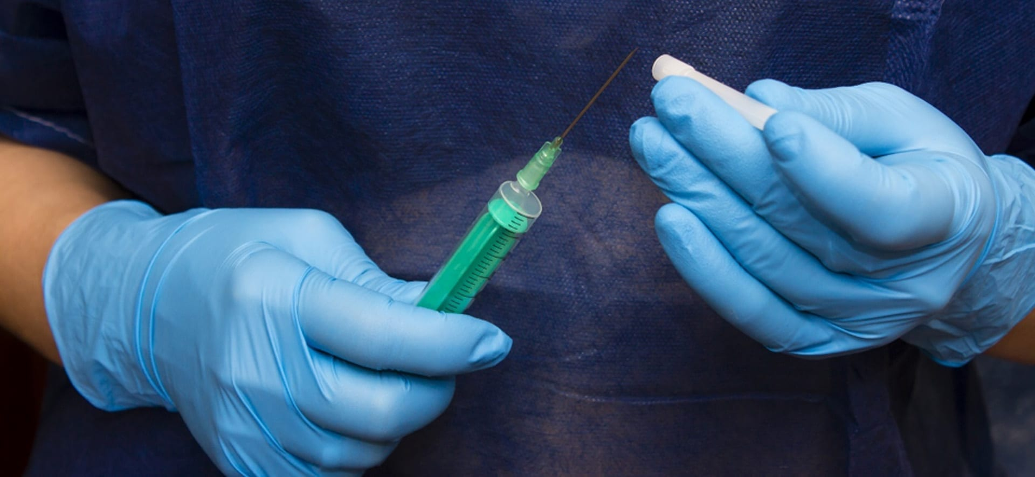
Medical Assistance in Dying (MAID)
Answers from the church

Slide 2
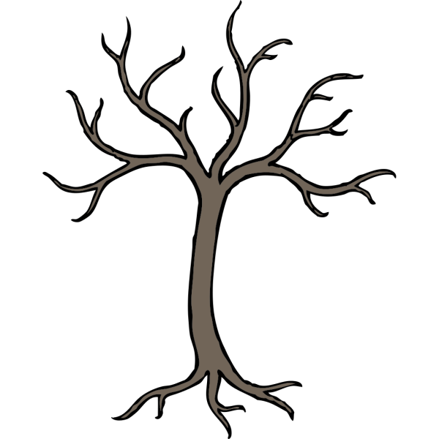
What Is Life?
According to the church, life is a gift given from God to all beings of the earth. It is stated many times in the Bible that life is sacred and should be protected. To have life is to be with God.
What Is Death?
According to the church, spiritual death is considered an enemy, as it is sin, and sin separates us from God.
As for physical death, although we do not fear physical death, we are called not to inflict it upon ourselves or upon anyone else for any reason.

Slide 3
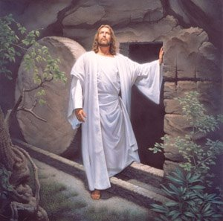
In The Bible…
Jesus is described as having conquered death, and having risen above it. This proves that death is not something to take lightly or to integrate into our lives.
So why would someone want to invite death?

Slide 4
Medical
What Is M.A.I.D?
Euthanasia, also known as M.A.I.D, is Medical Assistance In Dying. It is the act of ending someone's life in order to stop the suffering brought on typically by some kind of disease or ailment.
Assistance
In
Death

Slide 5
Different Degrees of Medical Interventions
Deprescription of medicine
Do Not Resuscitate order (DNR)
Medical Assistance
In Dying (MAID)

Slide 6
Different Degrees of Medical Interventions
Deprescription of medicine
Do Not Resuscitate order (DNR)
Medical Assistance
In Dying (MAID)

Slide 7
What are Futile Interventions?
Before we talk about different levels of care, we must first speak about Futile Interventions. These are treatments that doctors feel the patient will not benefit from because they are very terminally ill. The intervention would cause more problems than it solves. Thus, in the interest of the patient, the doctor will not go through with these measures.

Slide 8
Deprescription of medicine:
Doctors ending someone's prescription to medicine that may save their life. This would hasten the process of their deaths, though many could argue that this is simply allowing nature to take its course. In most cases, the side effects of taking the medication will be greater than any potential benefits of taking the medication.

Slide 9
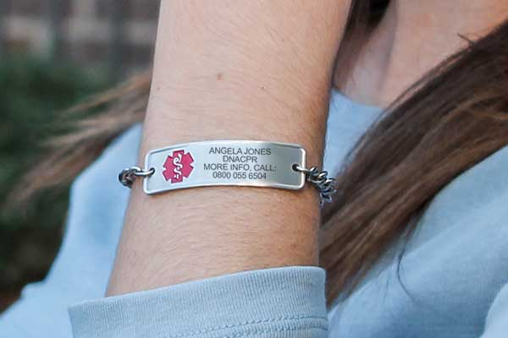
Do Not Resuscitate order (DNR):
An agreement between patients and doctors deciding not to go through with life saving measures during a medical event (such as when breathing or the heart stops). Typically reserved for the terminally ill.

Slide 10
Palliative Care
Palliative care is NOT MAID. For those undergoing palliative care, the doctors have already de-prescribed normal medication, and the patient is DNR, and are now prescribing medicine to make someone comfortable while they die.
These medications are not meant to hasten someone’s death but rather to make someone comfortable.

Slide 11
M.A.I.D.
Doctors agreeing to administer medications in order to cause someone's death. This is MAID.

Slide 12
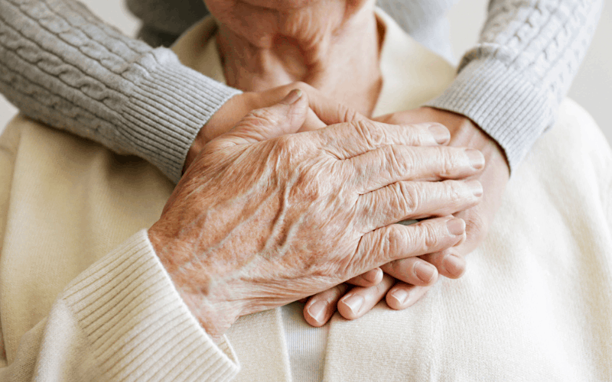
Why Might Someone Want To Die?
Terminal illness is by far the most accepted reason (for some people) for using medical assistance in dying, however, it is not accepted by the church. If someone does not believe they can live a fulfilling life due to their illness, they may want to end it in order to stop the suffering that comes with having their disease. Often these people are often already near the end of their lives and see no point in extending their time on earth.
Genesis 9:6
“Whoever sheds human blood, by humans shall their blood be shed; for in the image of God has God made mankind.”

Slide 13
Why would we want to extend life?
It gives us more chances to repent
It gives us more chances to grow closer to God
It gives us time to repair relationships in our lives
It gives us time to find happiness and peace
Regardless of how much time we have, or how hopeless it may seem, we must always remember that life is a gift and that there is always joy to be found.

Slide 14
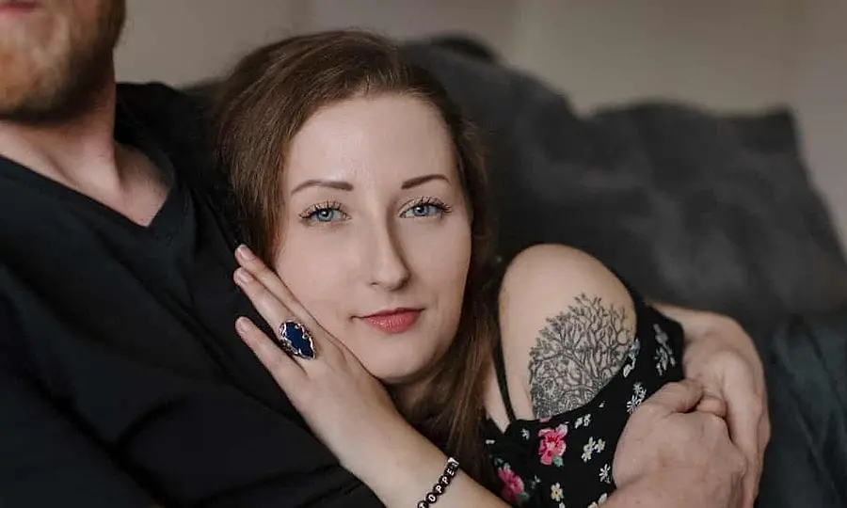
Recent Developments
On May 16 of this year, 26 year old Zoraya ter Beek had her application for euthanasia approved, citing unbearable mental anguish caused by her depression as the reason she wanted to be euthanized
Mental Illness and MAID
There are some that believe that mental illness should also be considered legal grounds for euthanasia. Thus, those with suicidal tendencies brought on by conditions such as severe depression and anxiety would be legally permitted to either take their own life or have a medical professional assist in their death.
This discussion has started fairly recently, and it is understandably a highly controversial topic.
https://www.thepublica.com/netherlands-physically-healthy-29-year-old-woman-approved-for-medically-assisted-suicide-because-of-her-depression/

Slide 15
ANSWERS FROM THE CHURCH
What is the Coptic view on MAID?
Fr. Kyrillos
“It would not be allowed in the Coptic Faith. It is written in Genesis right after the flood, God prohibited anyone to take the life of anyone else. You may be able to find it in Genesis 9.”

Slide 16
ANSWERS FROM THE CHURCH
Is there anyone who may be able to get MAID?
Fr. Kyrillos
“The answer is no. God is the sustenance of life. Without God, there is no life. If God is to give me my life, who am I not to take it? If a sick person is alive, it is because God gave them that life. The suffering they may be facing is a consequence of the original sin. Life itself is a gift. Am I more knowledgeable than God, or more loving? By permitting myself to take their life, I would be putting myself above God.”

Slide 17
ANSWERS FROM THE CHURCH
What about those with mental illness?
Fr. Kyrillos
“Opening the door to considering MAID as an option is what has allowed this discussion surrounding mental illness to occur. From a Christian perspective, it is unethical.”

Slide 18
What To Remember Going Forward
Remember this may one day happen to you.
We must always remember the gift that is life.
Always make use of your life as a chance for repentance.
Take this lesson as an opportunity to evaluate your own life and what you appreciate about it. Remember to take advantage of the time you have to grow closer to God as well as to the people around you.

